Slide 1


vManage Statistics Dashboard
GVE DevNet
Global Sales Segment : Global Enterprise
Industries : Manufacturing
LoB : Operation Analytics
Architectural Plays : Enterprise
Sales Plays : Secure SD-WAN
Josh Ingeniero
Technical Solutions Specialist
October 2020
Notes:
Notes: If your use case applies to morer than one or even all industries please keep all the industries and BOLD the industry where the PoV fits.
Smart City/Health Care/Industry and Manufacturing/Hospitality/Education/Retail/Utilities/Logistics/Professional Services/Public Sector/Service Provider
For LoB applies the same : if there is just one LoB, delete others, and bold the LoB that PoV is about.
LoB ; Safe and Security/Operations Automation/Human Resources/Operation Analytics
Please only keep the Architectural Plays that PoV is about.
Architectural Play : Enterprise / Data Center / Security / Collaboration / Service Provider

Slide 2

Manufacturing
Operations Analytics
Notes:
Please under Industry Alignment just types the Industry that PoV was created as well LoB
For the pictures, when you go to the bx.cisco.com link and select brand categories and the select photograpy you can use the engine text box to look for industry pictures and download it

Slide 3
vManage Statistics Dashboard
Business Needs/Challenges
Need: There is a clear need for operational network insights in day-to-day network flows. These insights must bring with them pertinent information with network performance statistics and any network issues or concerns. Visualising this information is also crucial for network and operations teams to understand and use.
Challenge: Easy, informative, and understandable network insights
Solution
Statistics from vManage will automatically be queried and stored for future use. Information can then be visualized and understood by different network and operations team to bolster business and network insights for future planning and remediation.
Business Outcomes
Faster time to resolution due to faster insights
Easier analytics for network and operations teams
Enriched insights due to helpful visualisations and statistics
Notes:
Notes :
At the top Select a short name of the PoV naming product or products involved
Insert the logo f the customer when applies (if it is a general use case ignore the insert logo)
For Business Needs/Challenges :
For bullet Need : Write a small sentence that in an objective way to express the problem to solve when you refer to this problem, avoid to use technical words, uses business language as C-Level
For bullet Challenge : Write the main challenge and drawback the customer has to solve the problem (also avoid technical words, make a message in C-Level)
Solution :
Describe in a small sentence what is the solution about to deal with the problem referred, again, please avoid to uses technical words and use C-Level language
Business Outcomes:
Use small paragraph to show the benefits and gains with the solution explained above, please avoide to uses technical words and use C-Level language

Slide 4

vManage Statistics Dashboard
Cisco SD-WAN Deployment
1
2
3
Collector Setup
Statistics Collection
Visualisation
The company configures their SD-WAN deployment and the Collector Container with the required credentials and measurements
The Docker setup is then run and will start collecting statistics
The Grafana dashboard will become available and be populated with statistics and graphs
Notes:
Notes :
Use this slide to explain the story around your solution. It is a prototype in high level point of view. Think about a explanation of your solution to an executive that does not know Cisco and deep dive technology
This slide it is also to share knowledge with a non-technical guy (like BDM or sales or C-Level) what is the solution about and how will work . You can do as many steps as you need to describe the main flow of the solution
LINK for Icons https://www.flaticon.com/

Slide 5
vManage Statistics Dashboard
Customer / Opportunity
Avery Dennison Corporation is a large multinational manufacturer and distributor of specialty products in the United States and several other countries. They are currently looking at implementing their SD-WAN infrastructure and are looking at ways to enrich their business and operations with appropriate information.
What is the story? What was the business challenge?
Avery Dennison Corporation, alongside their partner, Orange, are looking at how they can best receive key informational insights on their networks and branches. They would like to use these insights and consume them in an easier way to bolster decision making and action for their business and operations teams.
What the PoV accomplished?
Statistics from vManage will automatically be queried and stored for future use. Information can then be visualized and understood by different network and operations team to bolster business and network insights for future planning and remediation.
What are the benefits to the customer?
Avery Dennison can have a faster time to resolution due to faster insights from their SD-WAN
infrastructure, have easier analytics for their network and operations teams, and enriched insights
due to helpful visualisations and statistics.
Notes:
Notes :
*** From the side to the rest you can use all technical wording and reference from Cisco APIs, integrations and tools
Please fill the slide thinking about technical people and the scope of this PoV (what it is cover from the solution proposed and if there is a limitation or need a special integration to be awared
Align the bullet
What are the benefits to the customer?
With the Business Outcomes that you explain in the business case slide. And also you can add technical benefits on this slide or future steps to be added later as following steps

Slide 6



High Level Design PoV
vManage
3
The Grafana Container will query the InfluxDB Container to visualise and show the statistics data
2
The Collector Container will store the statistics data to an InfluxDB Container
The visualisations can be seen on the Grafana Web Dashboard
4
1
The configured Collector Container will start to query statistics from vManage using API’s
https://wwwin-github.cisco.com/gve/vmanage-statistics-dashboard
https://github.com/gve-sw/vmanage-statistics-dashboard
Notes:
Notes:
Describe the High level design and flow for the PoV and mentioned the tools used
Do not forget to add the link to github repository or other specifcs needs

Slide 7
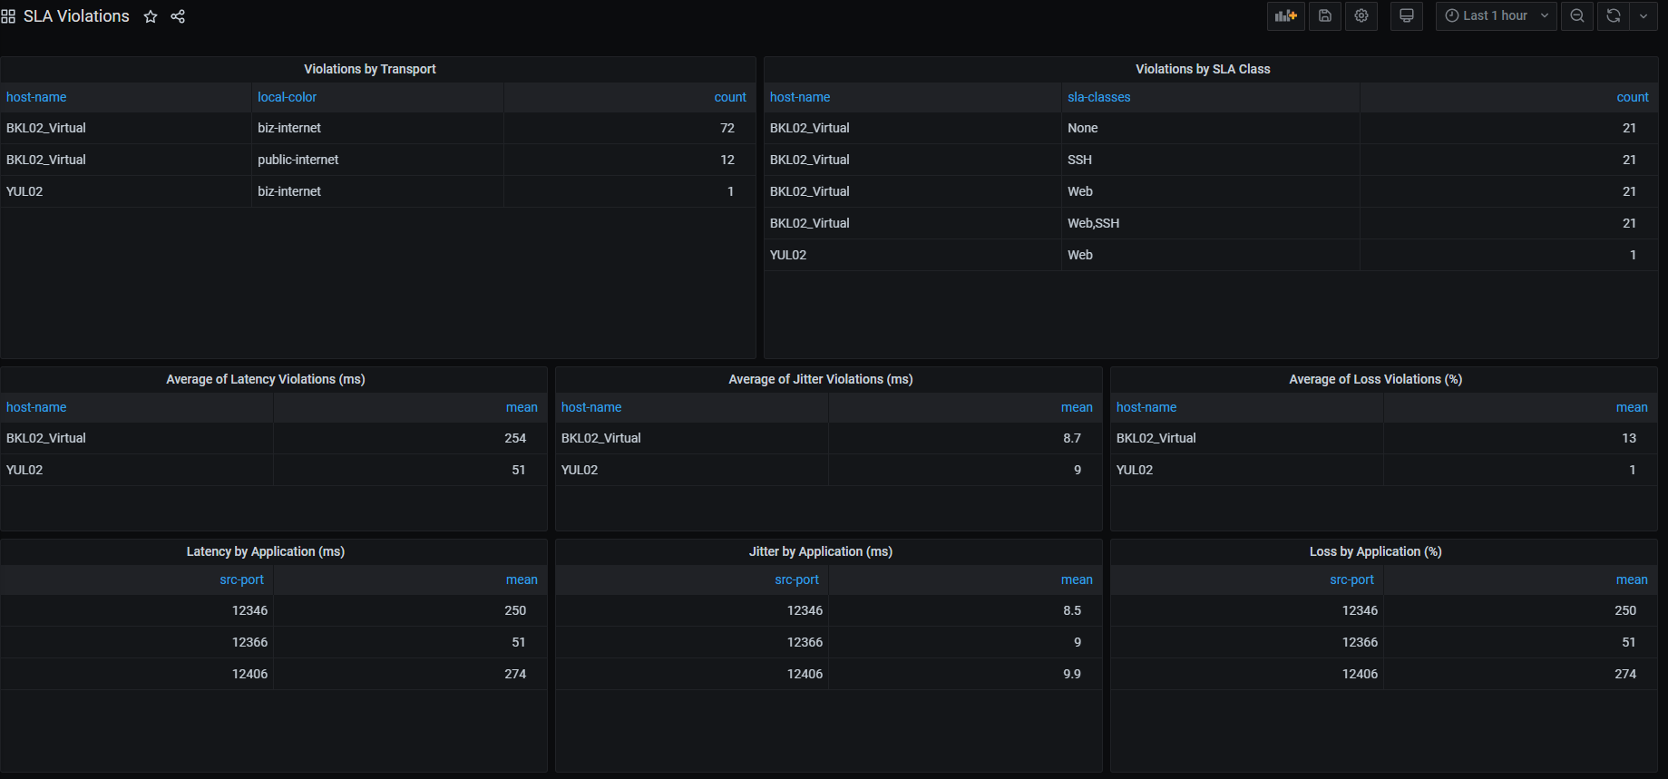
Show GUI or mockup
SLA Violations Dashboard
Notes:
Notes :
Some of the PoVs are developed either Sandboxes from dcloud, devnet or customer premises lab.
In the case the PoV is execute under Customer Premises Lab and would be hard to replicate the PoV, Please record video with the Demo and add the link to it.

Slide 8
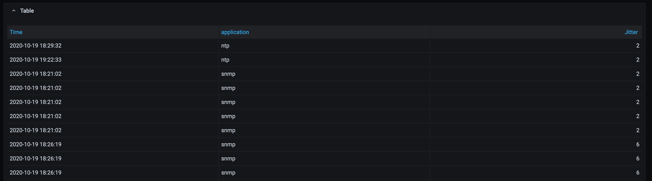
Show GUI or mockup
Application and Jitter Correlation
Notes:
Notes :
Some of the PoVs are developed either Sandboxes from dcloud, devnet or customer premises lab.
In the case the PoV is execute under Customer Premises Lab and would be hard to replicate the PoV, Please record video with the Demo and add the link to it.

Slide 9
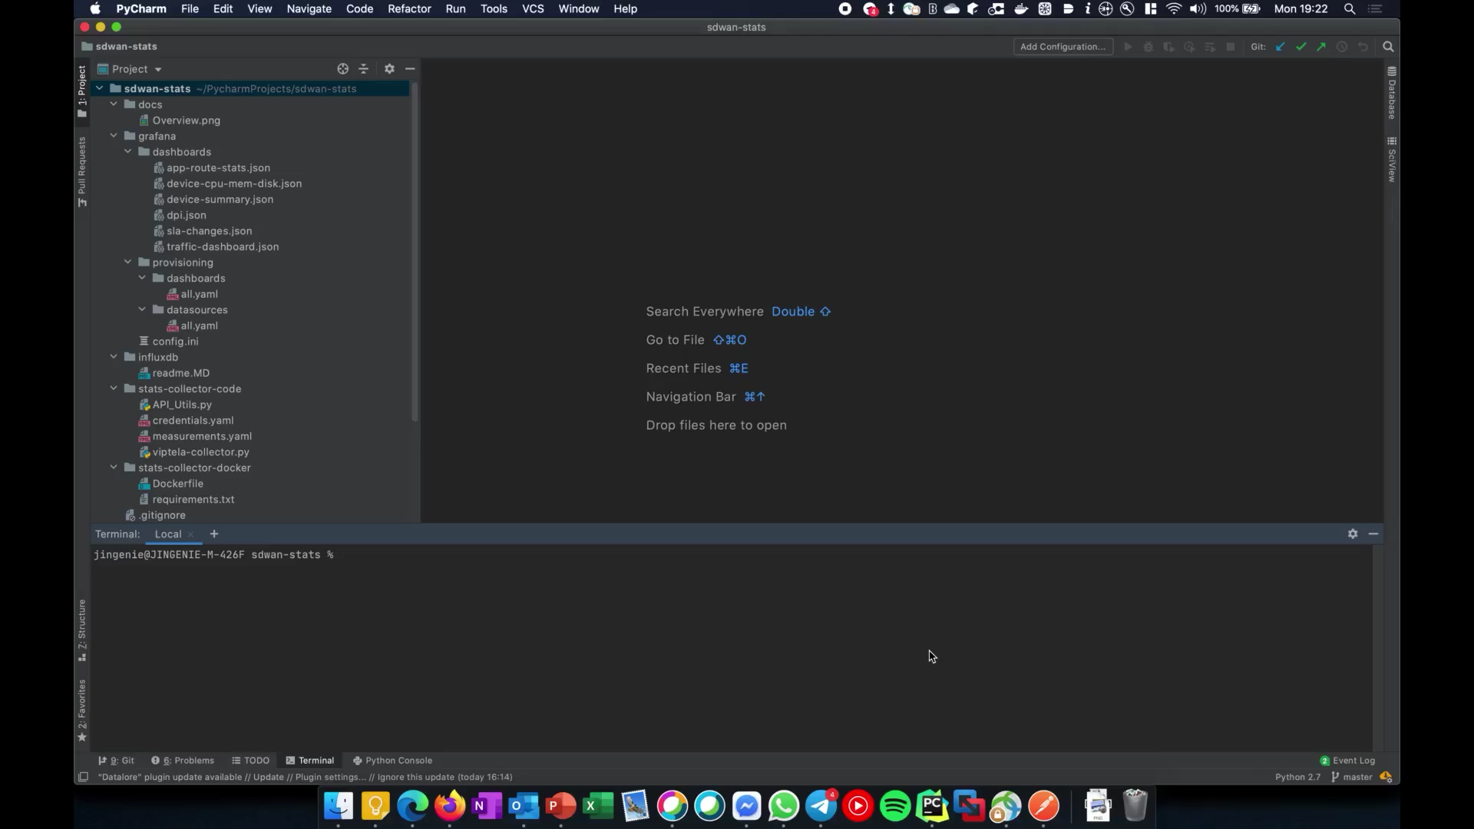
Show GUI or mockup
Video
Notes:
Notes :
Some of the PoVs are developed either Sandboxes from dcloud, devnet or customer premises lab.
In the case the PoV is execute under Customer Premises Lab and would be hard to replicate the PoV, Please record video with the Demo and add the link to it.

Slide 10
Tools (products) Used
Flask
Docker
Python
Grafana
InfluxDB
Cisco vManage API’s
Notes:
Notes :
Describe all the tools,
If there is a need for a specific licenses or code versión or hardware specifications mentioned here

Slide 11
Check out the GVE Devnet team @
https://gve-devnet.cisco.com/
Open a GVE case @
https://cep.cloudapps.cisco.com/case

